Slide 1

NetflixViz: Empowering Data-Driven Decisions in the Streaming Industry
GROUP-10
Nikhitha Thakur – 11711027
Laxmi Narayana Mangilipally - 11605829
Venkata Naga Pragna Sahas Gundavarapu- 11596183
Krishna Vishesh Katta – 11708016

Slide 2
INTRODUCTION TO DOMAIN:
This initiative specializes in leveraging advanced analytics and visualization techniques to analyze Netflix's vast dataset, offering valuable insights into content distribution, viewer preferences, and long-term trends within the media and entertainment sector, with a specific emphasis on streaming service analytics.

Slide 3
DATA ABSTRACTION (TYPES AND ATTRIBUTES)
The used data set consists 12 different attributes followed by its type. show_id: Unique identifier for each title (DataType: Numeric or String), type: Type of title (Movie or TV Show) (DataType: Categorical - String), title: Title of the movie or TV show (DataType: String), director: Director(s) of the title (DataType: String), cast: Cast members of the title (DataType: String), country: Country or countries where the title was produced (DataType: String) ,date_added: Date when the title was added to Netflix (DataType: Date), release_year: Year when the title was released (DataType: Numeric), rating: Content rating of the title (DataType: Categorical - String), duration: Duration of the title (DataType: String), listed_in: Categories or genres the title belongs to (DataType: String), description: Brief description or summary of the title (DataType: String.)

Slide 4
DATA ABSTRACTION (DETAILED DESCRIPTION)
The dataset provides details about movies and TV shows available on a streaming platform. Each entry includes information such as title, type, director, cast, country, date added, release year, rating, duration, genre, and description. It consists of a variety of genres including children & family movies, comedies, stand-up comedy, sci-fi & fantasy, thrillers, and more. The dataset covers a wide range of release years, from 2013 to 2019. Titles originate from various countries including the United States, India, Spain, and more. Content ratings vary from TV-Y7 to TV-MA, indicating which age it is suitable for. Both single movies and TV series with multiple seasons are represented. It offers insights into the diverse content library of the streaming platform, different tastes and preferences. This dataset serves as a valuable resource for content analysis, recommendation systems, and understanding audience preferences in the streaming industry.

Slide 5
DATA ABSTRACTION(NUMBER OF RECORDS)
The dataset consists of 6234 number of rows. In the context of the provided dataset of Netflix titles, the number of records tells us how many individual movies and TV shows are included in the dataset. Each record represents a specific title available on Netflix, whether it's a movie or a TV show. Therefore, the number of records gives us insight into the size of the dataset and the scope of titles that are being analyzed or considered.

Slide 6

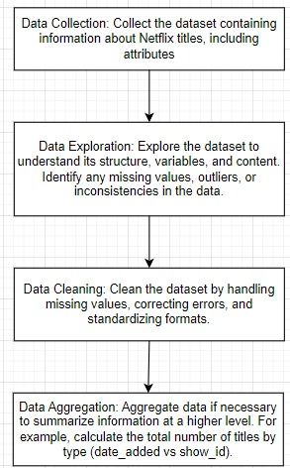
WORKFLOW DIAGRAM WITH EXPLANATION

Slide 7
DATA ABSTRACTION(DATA TRANSFORMATION)
Parsing Dates: Converting the "date_added" column from a string format to a datetime format for easier date-based analysis. Feature Engineering: Create new features such as "year_added" to extract the year from the "date_added" column, or "cast_count" to represent the number of cast members
Aggregation: Aggregate data to summarize information, such as counting the number of titles per country or genre
Handling Missing Values: Check for missing values in the dataset and decide on appropriate strategies for handling them, such as imputation or removal

Slide 8
TASK ABSTRACTION
TASK
Target: Providing analysis for TOTAL MOVIES AND TV SHOWS BY COUNTRY, RATINGS, MOVIES AND TV SHOWS DISTRIBUTION, TOTAL MOVIES &TV SHOWS BY YEARS,TOP 10 GENRE.
Action-1: Users can view a map chart showing the distribution of movies and TV shows by country.
Action-2: Users can view a stacked bar chart showing the distribution of different types of ratings by number

Slide 9
TASK ABSTRACTION
TASK
Action-3:Users can view a pie chart showing the distribution of movies and TV shows by number.
Action-4:Users can view area chart showing the distribution of movies and TV shows by year.
Action-5: Users can view horizontal bar chart showing the distribution of genre by number.

Slide 10
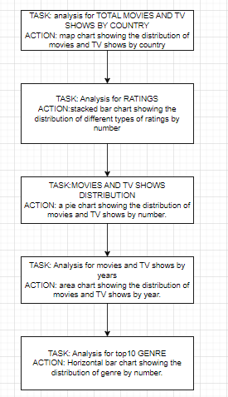
TASK ABSTRACTION
WORKFLOW DIAGRAM

Slide 11
IMPLEMENTATION USING TOOLS
TOOLS USED
Drag-and-Drop Interface: We’ve used drag-and-drop interface as it allows users to easily create visualizations by dragging fields from their dataset onto shelves to define rows, columns, colors, sizes, and marks
Show Me: The "Show Me" feature in Tableau suggests appropriate visualization types based on the data fields selected by the user. It provides a quick way to explore different visualization options and choose the most suitable one for the data.

Slide 12
IMPLEMENTATION USING TOOLS
TOOLS USED
Visualization Types: Tableau includes visualization types, such as Bar charts, Line charts, Scatter plots, Pie charts Heatmaps, Treemaps , Gantt charts Maps.
Dashboard: By using this we can combine multiple visualizations into interactive dashboards. Dashboards enables to create cohesive, multi-pane layouts that allow for comprehensive data exploration and analysis in a single view.

Slide 13
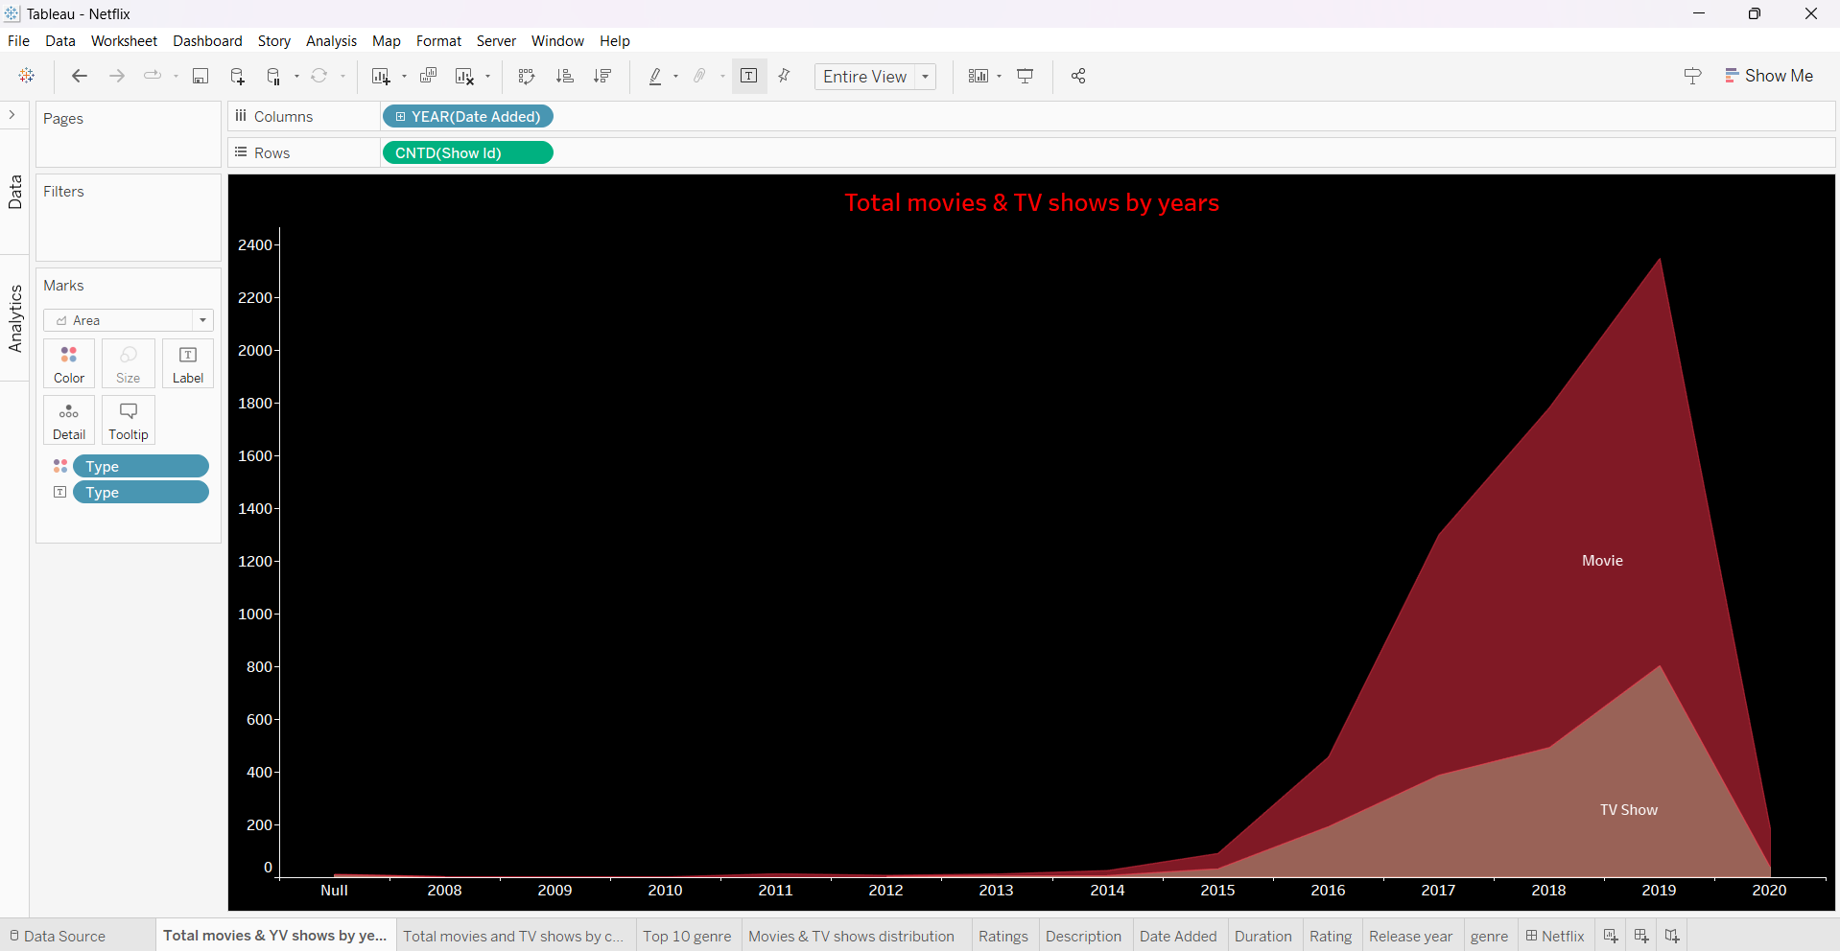
VISUALIZATION GRAPHS WITH EXPLANATION
VISUALIZATION-1:
In this visualisation we have date_added in columns as well as show id in rows where measure is set as Count(distinct) the type is present in colours as well as labels fill stop the date added is present in filters. In format shading the worksheet is set to be black. The colour of the area chart is also changed to red which can be obtained in the marks - color.

Slide 14
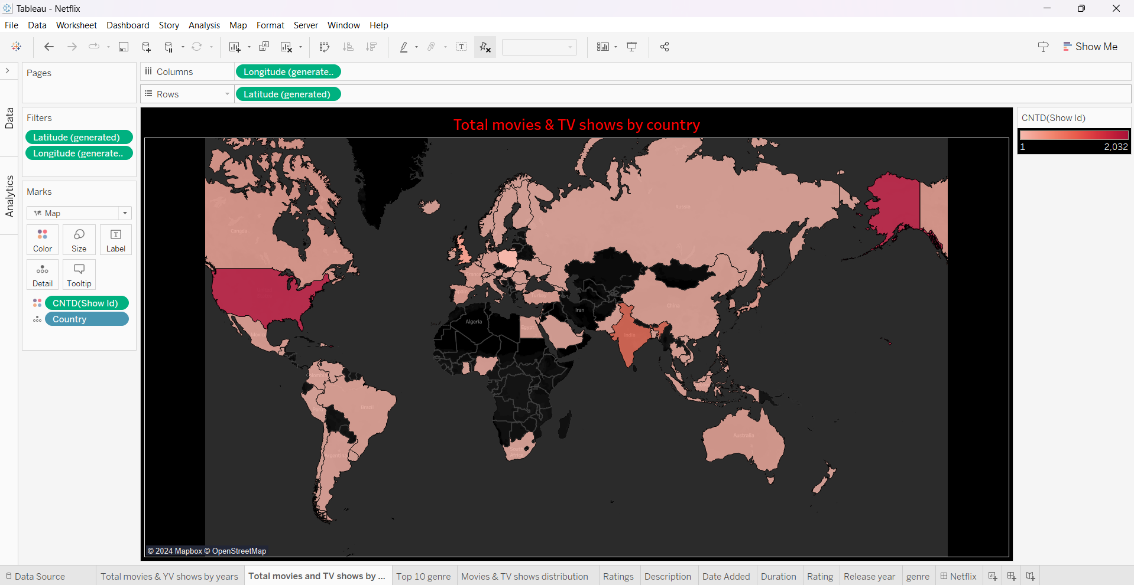
VISUALIZATION GRAPHS WITH EXPLANATION
VISUALIZATION-2:
In this visualisation we choose the attribute country and select it representation to map which can't be done by using marks category longitude and latitude are placed in columns and rows respectively. Then add show_id into the colour and set its measure as count distinct. We then change the colour of the map to be in red which can be obtained by using format shading.

Slide 15
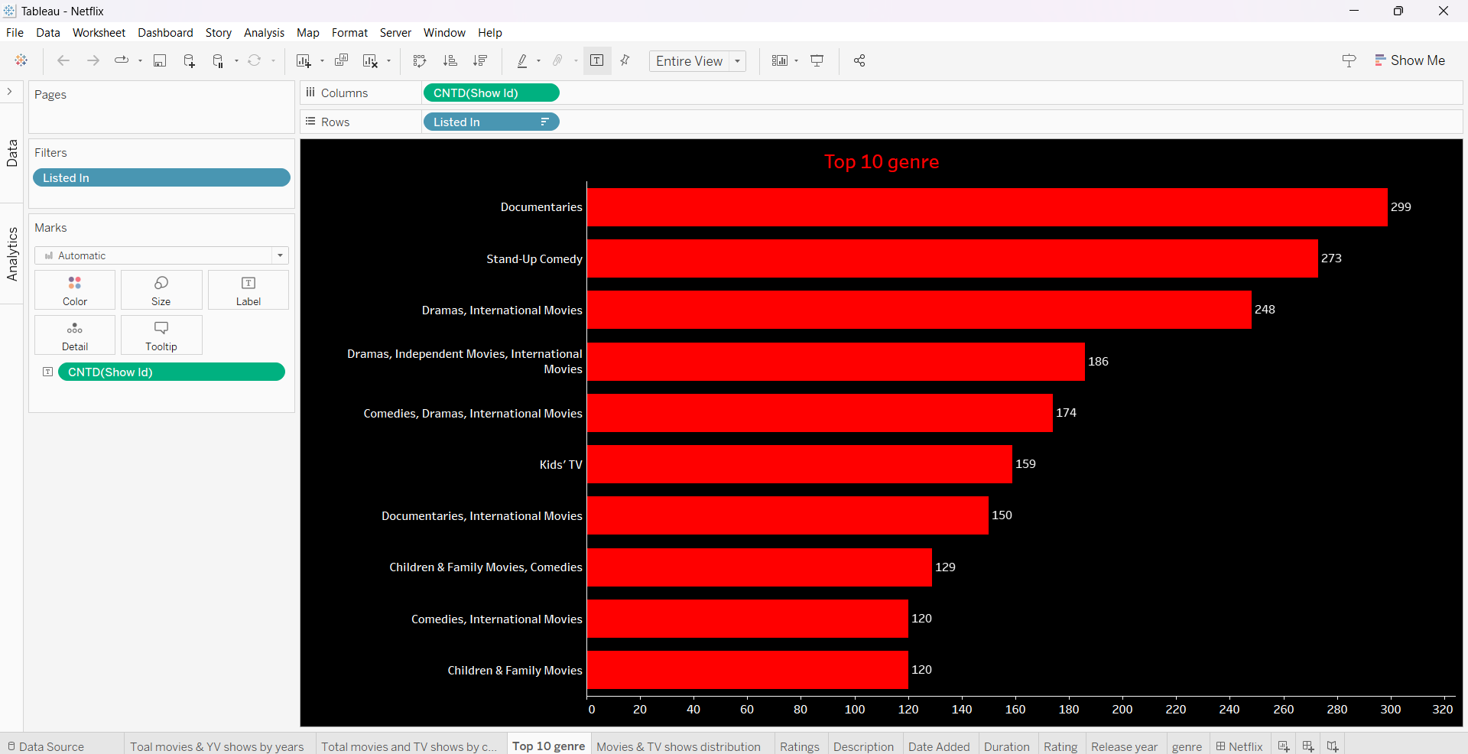
VISUALIZATION GRAPHS WITH EXPLANATION
VISUALIZATION-3:
In this visualisation we choose the show ID and make its count to be distinct while the listed_in is placed in rows by selecting top 10 and then in filters. We then place the show_id in columns which generated horizontal bars and change its background using format shading.

Slide 16
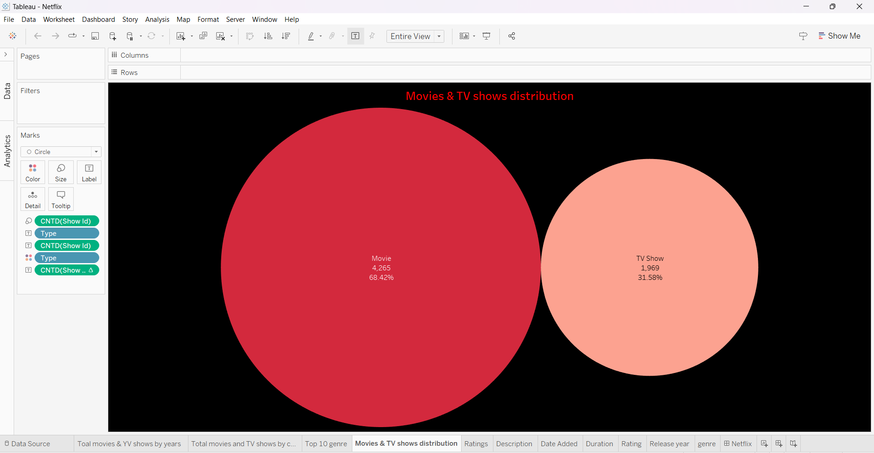
VISUALIZATION GRAPHS WITH EXPLANATION
VISUALIZATION-4:
In this visualisation we choose the type to be in rows and then we select the show ID and make its value as count distinct and place it in colours. By clicking one show me option choosing packed bubbles visualization. Adding show_id to label gives us the total number of movies and tv shows. To add percentage, add show_id to detail and change its quick table calculation to percent of total.

Slide 17
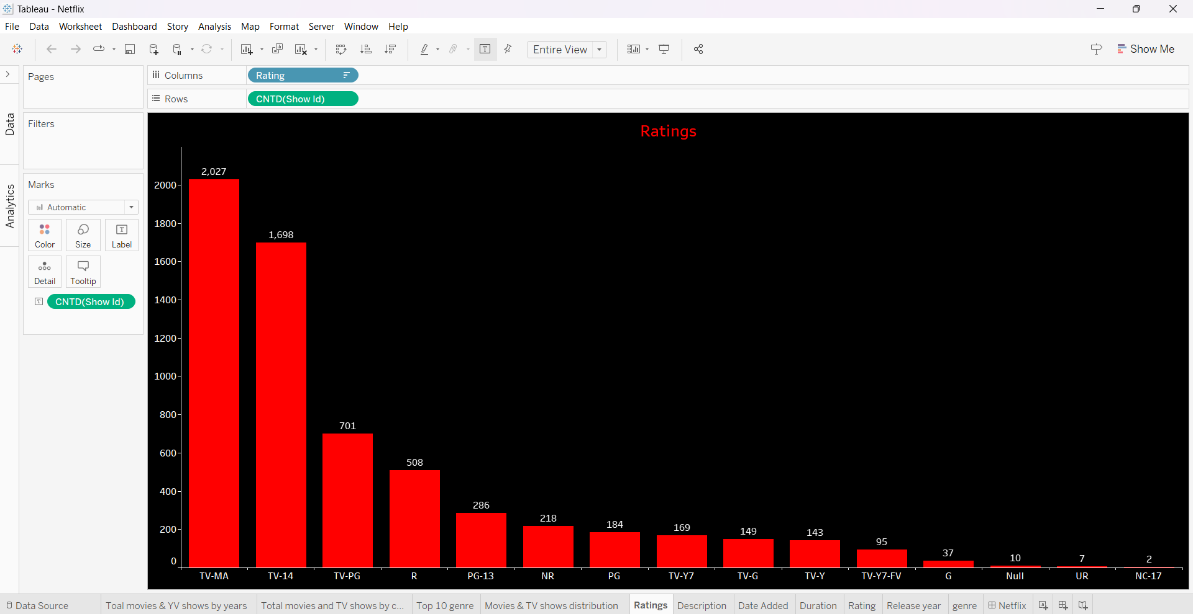
VISUALIZATION GRAPHS WITH EXPLANATION
VISUALIZATION-5:
In this visualisation we choose the rating to be in columns and show ID in rows by specifying its count to be distinct. Drop the count show_id to labels and change the background and text by using format tool.

Slide 18
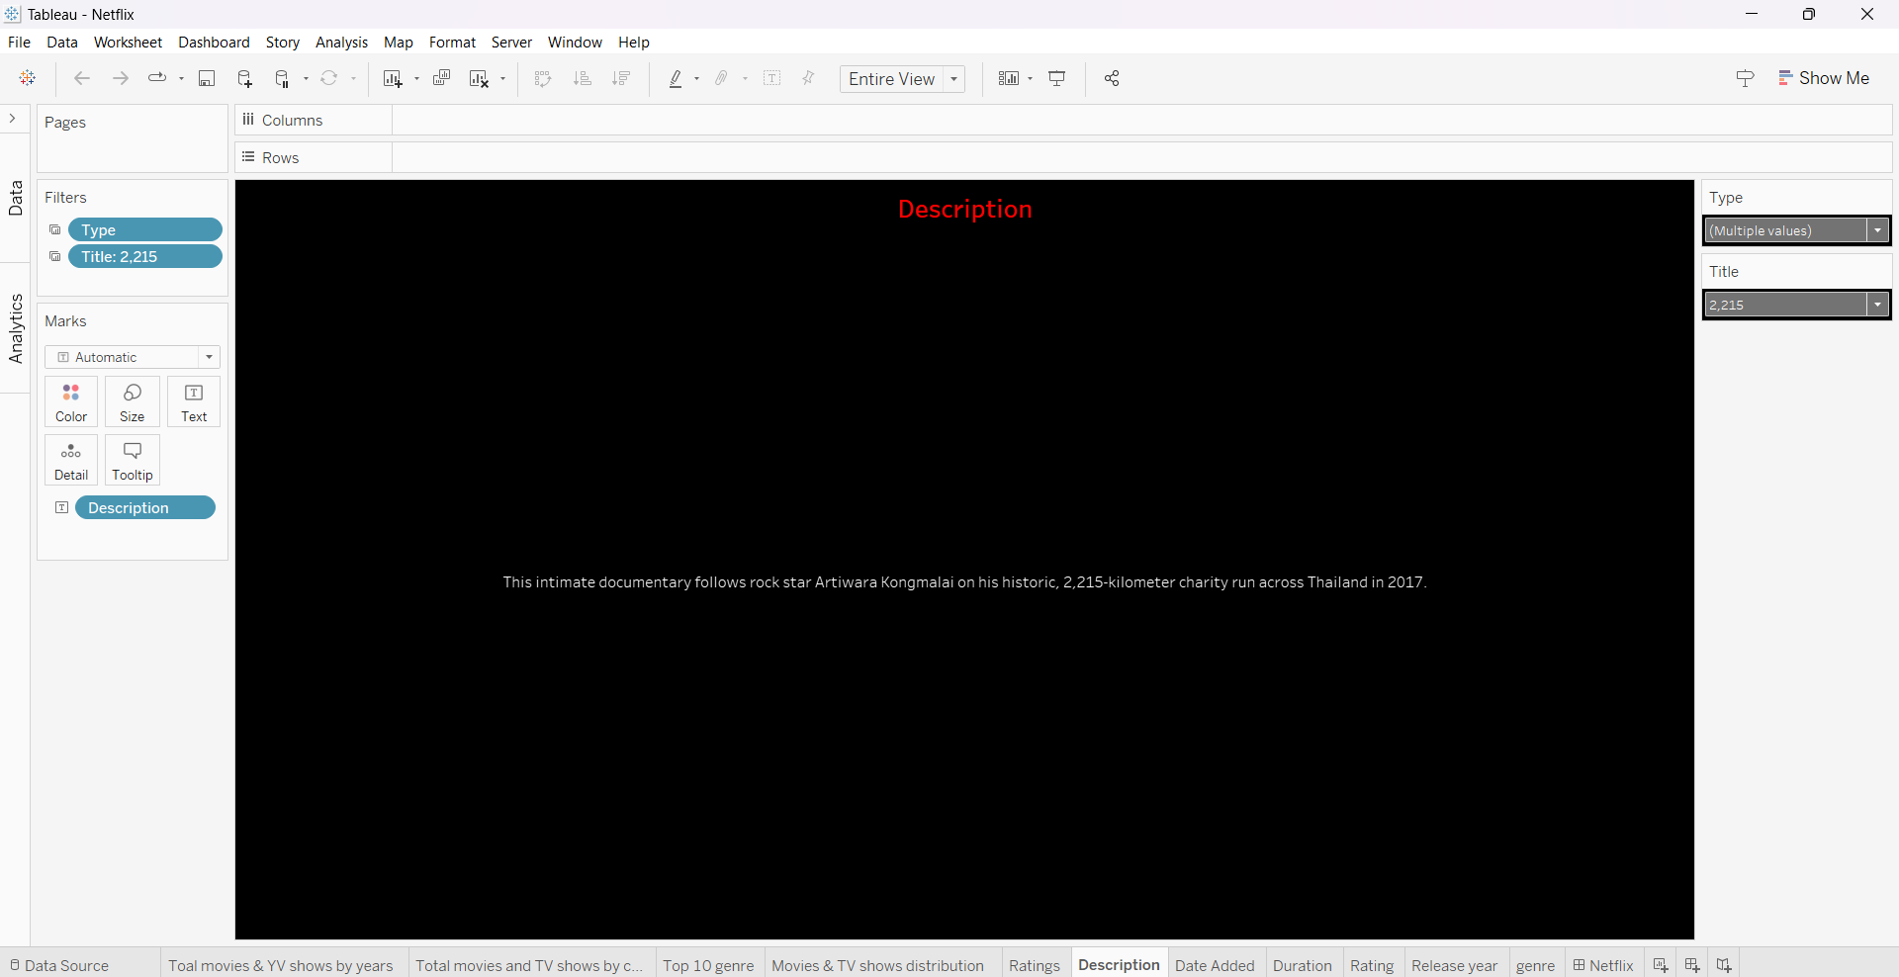


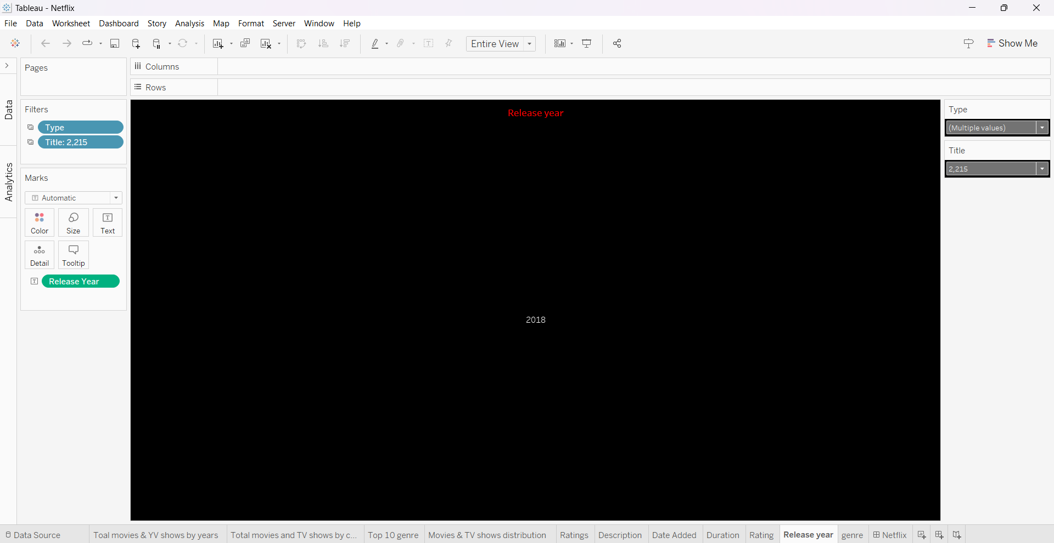


VISUALIZATION GRAPHS WITH EXPLANATION
VISUALIZATION-6:
In this visualisation we choose the type and drop it in filters then we choose the type to be single value and the same with the title attribute. In type the attribute but be selected to be only relevant values. Description ins placed in text and chosen to be in entire view. We perform required formatting to obtain the required visualization. Now we duplicate the same sheet and place the date added in text. The same procedure is followed sheets for duration, rating ,release year and genre.

Slide 19
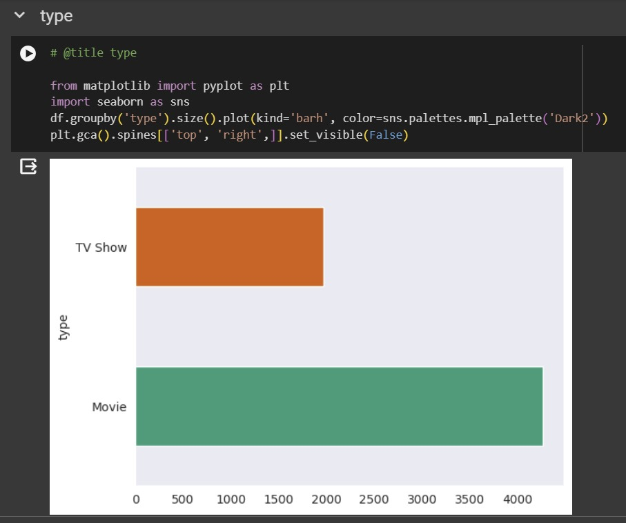
Python Visualizations

Slide 20
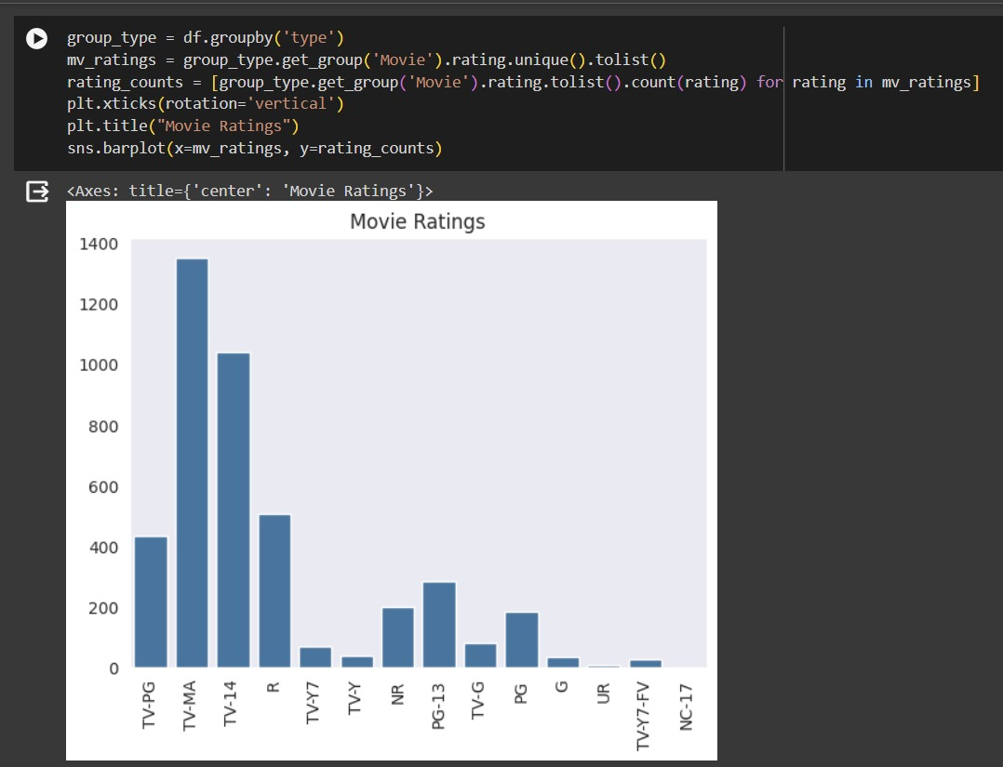
Comparing TV Shows and Movie Ratings

Slide 21
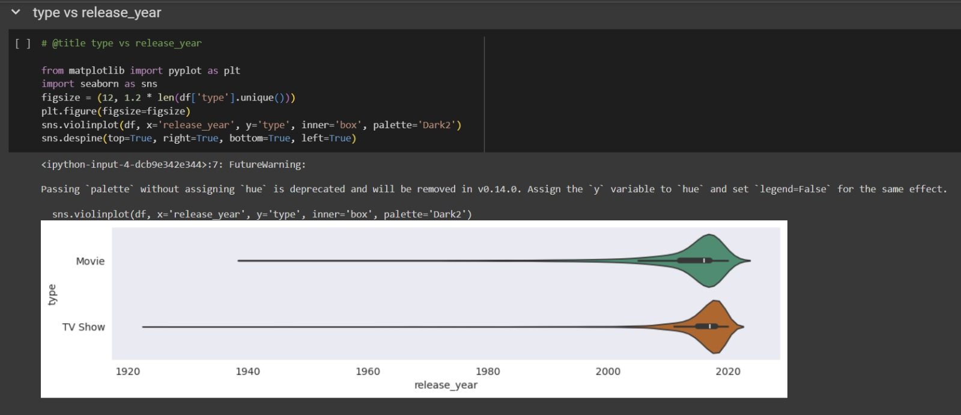
Distribution of Movies and TV Show releases over past years

Slide 22
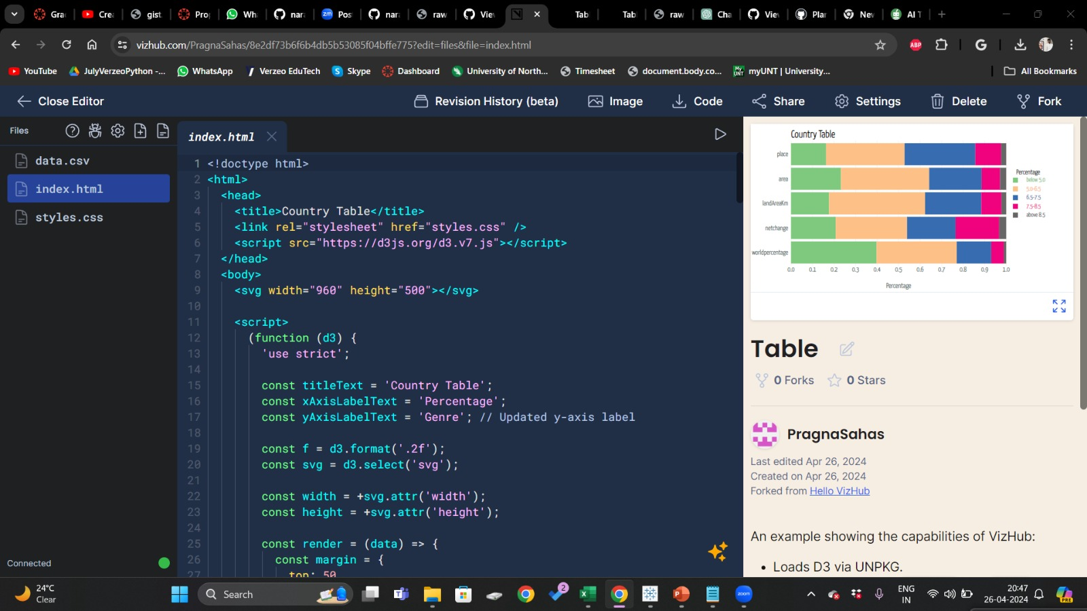
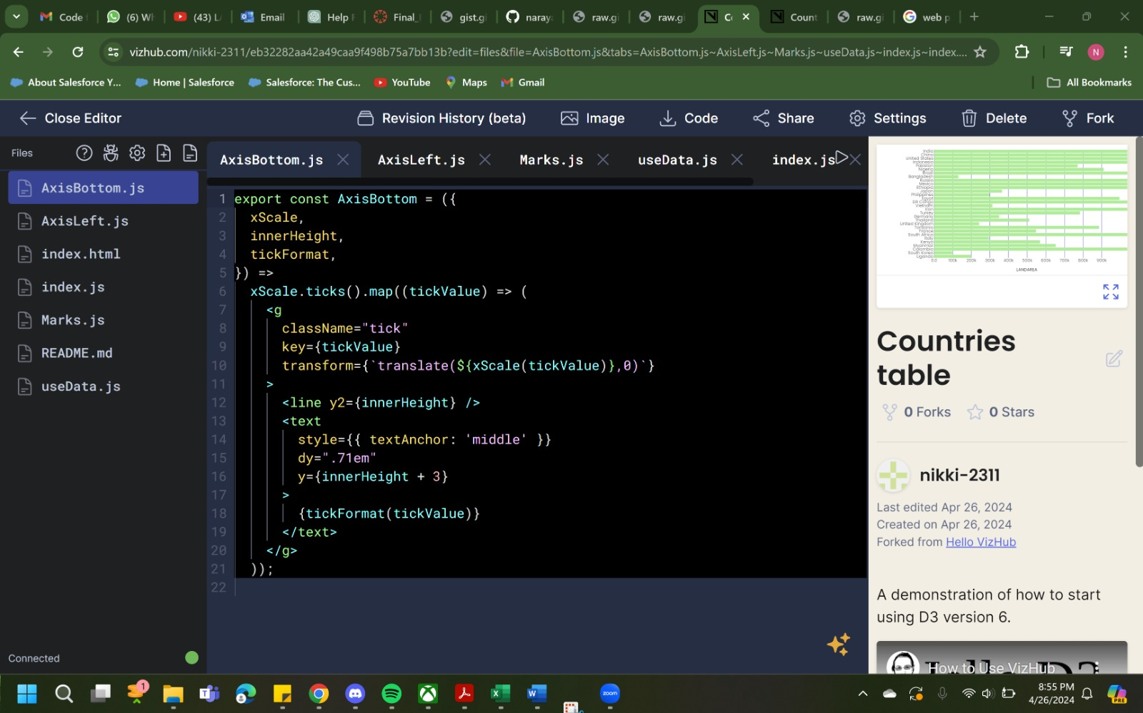
D3.js VISUALIZATIONS
Link1: https://vizhub.com/PragnaSahas/8e2df73b6f6b4db5b53085f04bffe775?edit=files&file=data.csv
Link2:
https://vizhub.com/nikki-2311/eb32282aa42a49caa9f498b75a7bb13b?edit=files&file=AxisBottom.js&tabs=AxisBottom.js%7EAxisLeft.js%7EMarks.js%7EuseData.js%7Eindex.js%7Eindex.html

Slide 23
WORK MANAGEMENT
IMPLEMENTATION STATUS REPORT:
-Conclusion: Created an interactive dashboard that shows the Netflix dataset and includes important information like the distribution of content types, trends in release years, and popularity of genres. Utilizing Python's robust analytics libraries—such as Pandas for data analysis and SciPy for statistical tests—to look for trends in audience preferences and content over time. These libraries can be used to identify and analyze these trends, yielding useful information that can inform distribution and production strategies. The dashboard will be enhanced with dynamic, data-driven narratives thanks to Python scripts that automate the extraction of insights from the dataset.
GITHUB LINK: https://github.com/narayana8799/CSCE-5290-Final-Project

Slide 24
WORK MANAGEMENT
RESPONSIBILITY/CONTRIBUTIONS:
D3.js,Tabeau: Nikhitha Thakur, Venkata Naga Pragna Sahas Gundavarapu
Python code, Tableau: Laxmi Narayana Mangilipally
Documentation, Tableau: Krishna Vishesh katta

Slide 25
REFERENCES/CITATIONS
REFERENCES:
Netflix Data: https://www.kaggle.com/datasets/shivamb/netflix-shows Shull, F. (2022). Mastering D3.js Data Visualization. Packt Publishing. Murray, S. (2017). Interactive data visualization for the web: an introduction to designing with D3. O'Reilly Media, Inc. Zhu, N. Q. (2021). Data visualization with D3. js cookbook. Packt Publishing Ltd.
CITATIONS:
[1] https://oyasalofa.medium.com/netflix-movies-and-tv-shows-tableau-dashboard-12fe06359b6b [2] https://www.tableau.com/blog/tableau-cloud-netflix-original-64442

Slide 26

Thank You

